Slide 1

TACLO’S
Drone Enabled Food Delivery

Slide 2
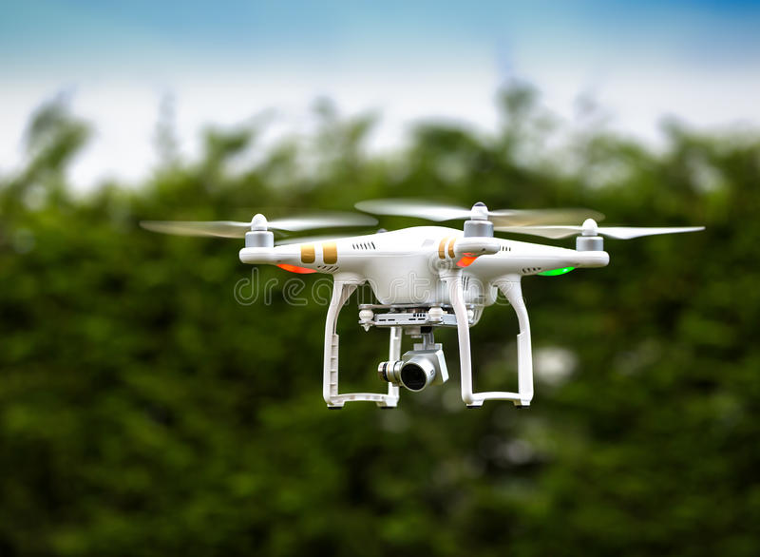
Project Submitted By
Ishan Shaikh
Kapil Bhusare
Karan Bindra
Kiran PK
Jaswanthi Tanakala
Abhijith
LETS GET STARTED

Slide 3



SITUATION & OBJECTIVES OF PROJECT
GOOGLE SLIDES
CURRENT SITUATION
OBJECTIVES
SOLUTION?
Currently, 70% of the orders are placed on the platform during the peak hours of lunch and dinner
High traffic during these peak hours limits the serviceability of restaurants to a few kilometers
Gap between demand and supply
Design an efficient drone-enabled delivery system
To fulfill the Demand and Supply Gap
Implementation of Drone enabled delivery system
To reduce the Delivery time due to high traffic at peak hours
YES!

Slide 4
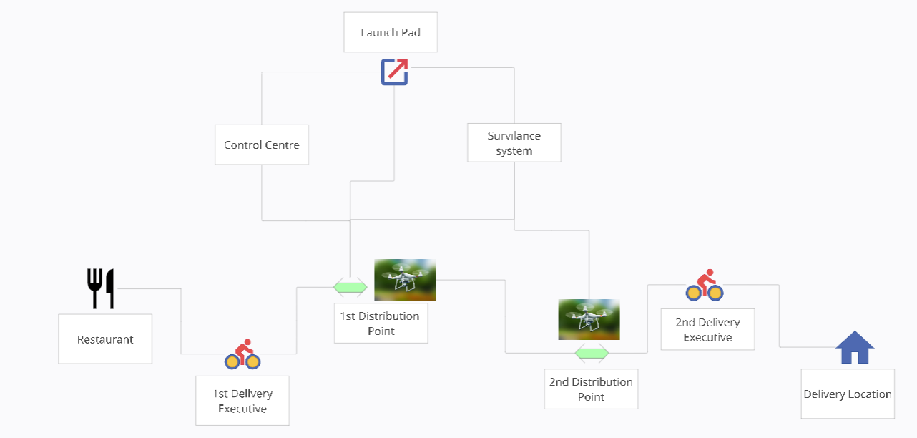





OPERATIONAL LAYOUT OF DRONE SYSTEM

Slide 5
OPERATIONAL FLOW SUMMARY
1.
2.
1.
Important Stages
2.
Key Points
3.
Advantages
Launch Pads
1st Distribution point
2nd Distribution point
Integrated system
Control center
Surveillance system
Customer service representative
Delivery Location
multiple Distribution points within the city
Integrated Systems
Distributions points with charging station
Maintenance, and Drone storage facility
Easy to handle the drone from ne specific station to different
We can avoid Accidents and Casualties since no one is directly involved
Cover the Main traffic areas
Reducing the Delivery time
Easy and efficient process.

Slide 6
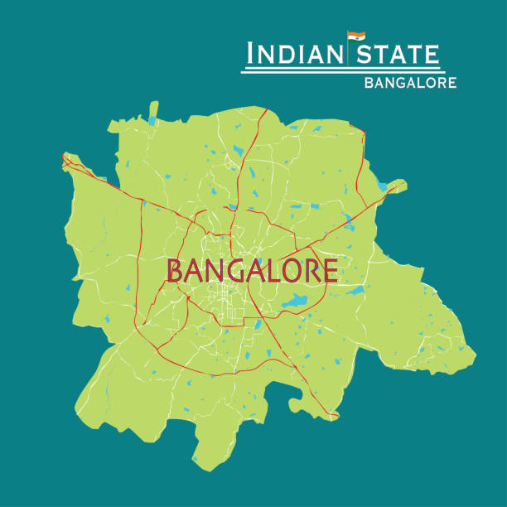




SETTING UP THE DISTRIBUTION POINTS WITHIN CITY

Slide 7
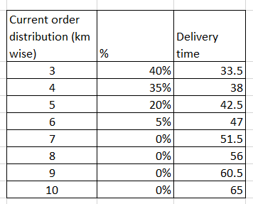
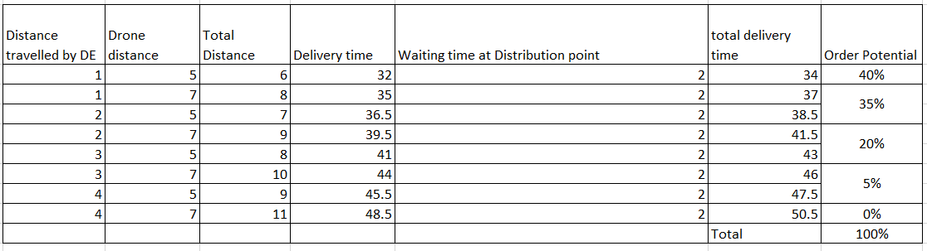
NEW UNLOCKED ORDERS

Slide 8
GROWTH IN REVENUE
After Implementing the Drone System, the YoY expected growth in Revenue

Slide 9
Order Getting from beyond 5 KM of Distance
Significant increase in the order count, from 0% to 40%

Slide 10
REVENUE GENERATION

Slide 11
CONCLUSION WITH SUMMARY
Growth in Revenue is negative for the first operational year due to high investment and Operational cost
As We go YoY basis, the growth is looking good for the Revenue
We are Unlocking the new orders within the area of 10 KM, which were 0% in the previous.
60% Growth on the incoming orders

Slide 12

Thank You

